Slide 1
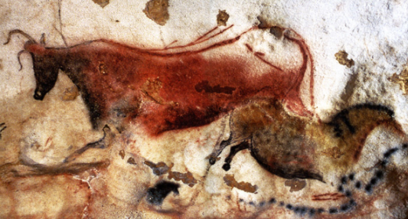
Hominid Evolutionary Trends
Ch 20 Cultural Evolution

Slide 2
Intro
In addition to anatomical and physiological evolution, hominins have developed complex cultures that allow them to survive better in their environment.
Cultural evolution can be seen in:
Tool and technology development
Development of methods for obtaining food
Increasing sophistication of language
Other changes including symbolic representation (eg visual art)

Slide 3
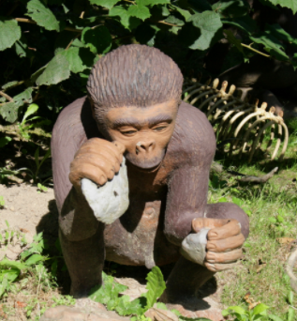
Australopithecine Culture
Home bases:
Lived in one place, left from there to forage for food
Use of fire?
No evidence found that Australopithecines deliberately used or controlled fire.
Tools
Limited evidence that tools were made, but rocks and sticks were likely used as tools.

Slide 4
Early homo
Larger brains than Australopithecines
Needed more complex fats and higher levels of protein
Therefore needed to consume meat.
Food sharing from large hunts would have been necessary – collaboration and interdependence
Males likely hunted, females gathered
Majority of food from gathering, with occasional large bounty from hunt
Cooperative culture requires development of language – not as complex as modern humans
Evidence of hunting: stone tools and also marks on bone to indicate tools not teeth used.

Slide 5
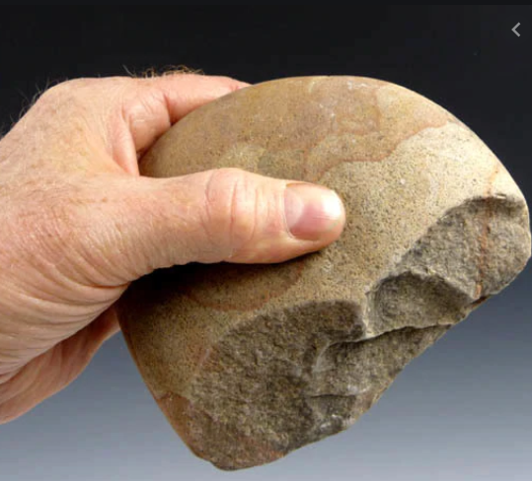
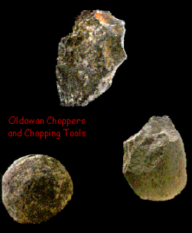
Homo habilis culture
Tool Use – Oldowan Tools
Range of pebble tools found: choppers, scrapers, flakers, chisels
Require precision grip
Tool use enabled colonisation of a broader range of habitats

Slide 6
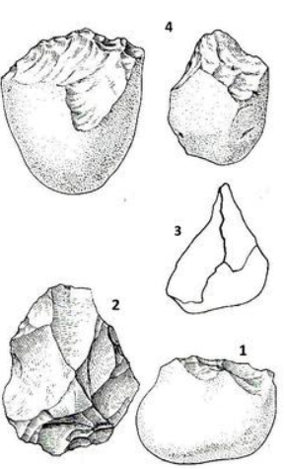
Oldowan tools examples
Note
Rough flaking
Unsophisticated
Not developed for specific purpose eg arrowhead/fish hook/knife etc.

Slide 7
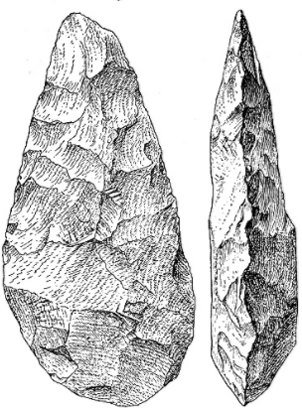
Homo erectus Culture
Modified environment to suit own purposes
Home bases:
Built shelters to protect from the elements
Terra Amata: site dating to 400 000 years ago
Wood huts
Evidence of fire use
Tools from stone and bone
Remnants of animal bone from hunting - also fish bones – fishing?
Use of fire?
Evidence that H.erectus used fire:
Kept predators away
Warmth and light
Used during hunting to drive animals
Cooking of food
Tools
Flaked around all edges, teardrop shaped “hand axes”
Referred to as Acheulean tools (from where they were first discovered)

Slide 8
Homo erectus Culture
Food:
Hunter- gatherer society
Most food from gathering, supplemented by hunting
Skilful, strategic hunters
Evidence of planning – planned baboon slaughter miles away from base
Drove elephants into swamps using fire, then butchered them
Sophisticated, systematic butchering using tools
Women used complex techniques and collaboration to gather food.
Balanced with child rearing
Social organisation
A result of hunting/gathering/use of tools and fire
Complex society, shared care
Relatively complex social language may have developed.

Slide 9
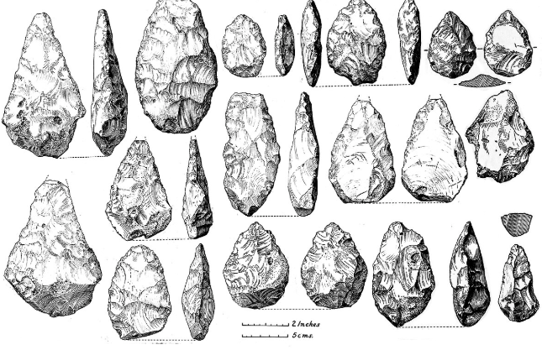
Acheulian tools – Homo erectus
Rough tear-drop shape
Not a lot of variation
General rather than specific use
Finer flaking than Oldowan
Bifacial – thin axe-like edges with two broader faces.

Slide 10
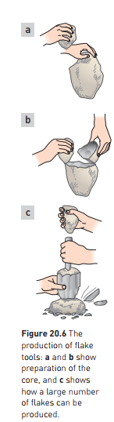
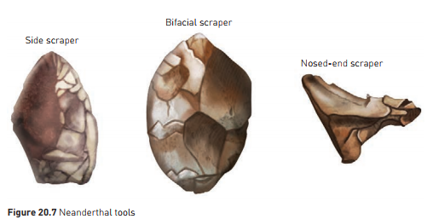
Neanderthal Culture
Further cultural advances – well able to manipulate environment
Tool making
Production of stone flakes which could then be trimmed to form various tools.
“Mousterian Industry” – advance over hand axes
Allowed clothing to be made

Slide 11
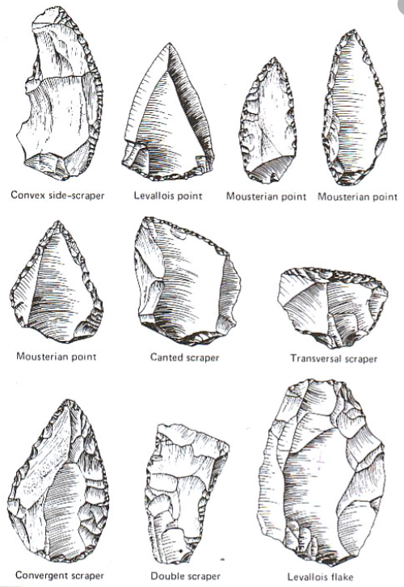
Mousterian Tools – Neanderthal Culture
Variety of tool shapes to suit different purposes eg scraping, stabbing
Relatively fine flaking to edges for sharpness

Slide 12
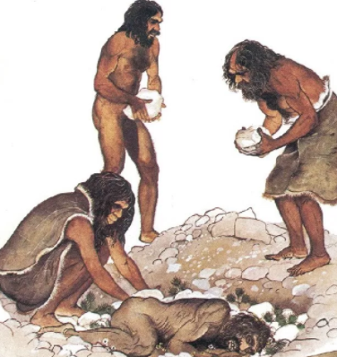
Neanderthal Culture
Burial of dead
With symbolic objects eg goat horns, flowers
Evidence of spiritual/religious belief?
Shared care and responsibility
Likely that Neanderthals took care of the disabled and elderly
Developed social system for sharing of food and other resources

Slide 13
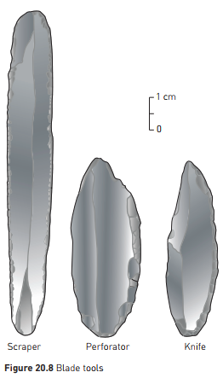
Transition to Modern Humans
50 000 years ago – new technologies
Finer blades
Projectile weapons
Sewn clothing
Better shelters
Blade tools:
Sharp, parallel sides – like a knife blade
Sophisticated hunting techniques
Meat, skins, oil for fire/lamps
Bones and ivory used to make tools

Slide 14
Transition to Modern Humans
3 main cultures in fossil record for Homo sapiens
Aurignacian (40 000 – 28 000 bce)
Solutrean (21 000 – 17 000 bce)
Magdelanian (17 000 – 12 000 bce)

Slide 15
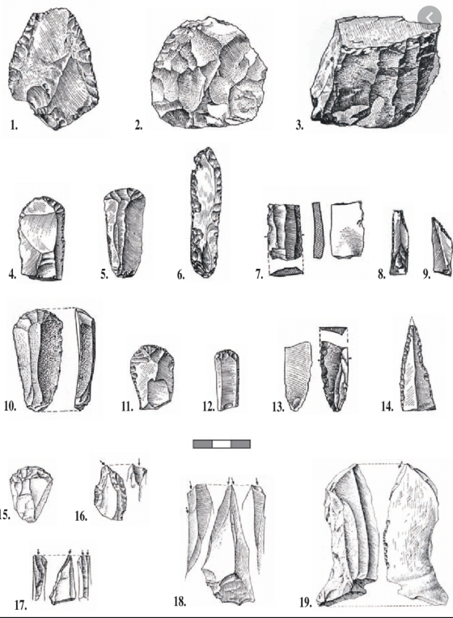
Aurignacian Tools
40 000 – 28 000 bce
Finer workmanship
Wide variety of tools for different purposes

Slide 16
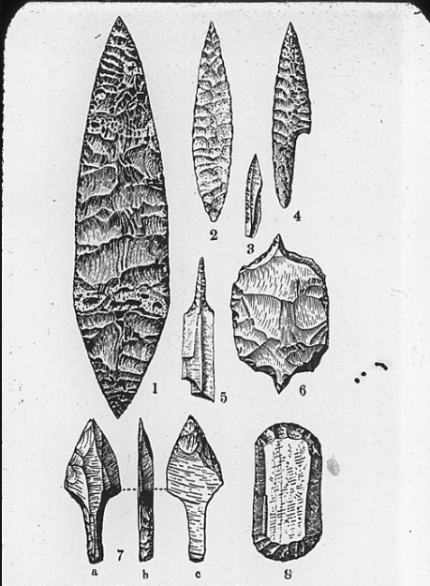
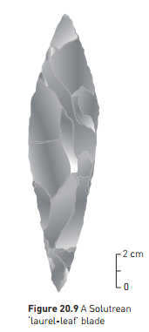
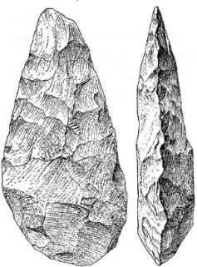
Solutrean Tools
21 000 – 17 000 bce
Variety of tools were made for different purposes
Complex, fine blades, pressure flaking
Symbolic blades were made in some instances.
Note: comparing Solutrean to Acheulian (Homo erectus) tools - solutrean tools have finer flaking and are much smaller and more elongated than the H. erectus tools
Acheulian hand axe

Slide 17
Transition to Modern Humans
Magdelanian
Bone and antler tools predominated
Barbed spears
Spear throwers
needles
Tool for making other tools – a stone “burin” chisel used for carving bone and antler
Some clay modelling
Art works
Portable – carved figurines
Mural art on cave walls
Use of colour and shading

Slide 18
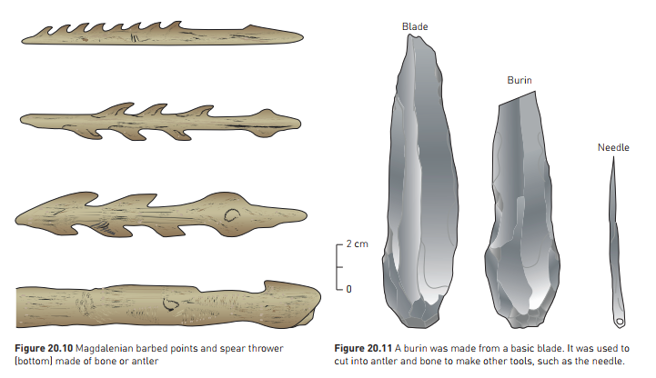

Slide 19
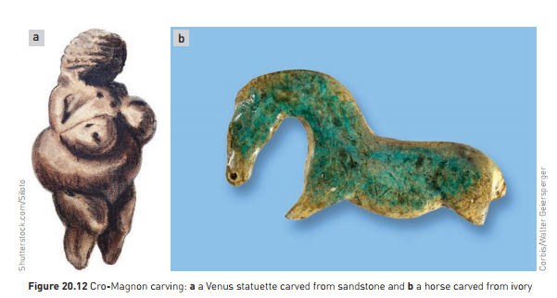

Slide 20
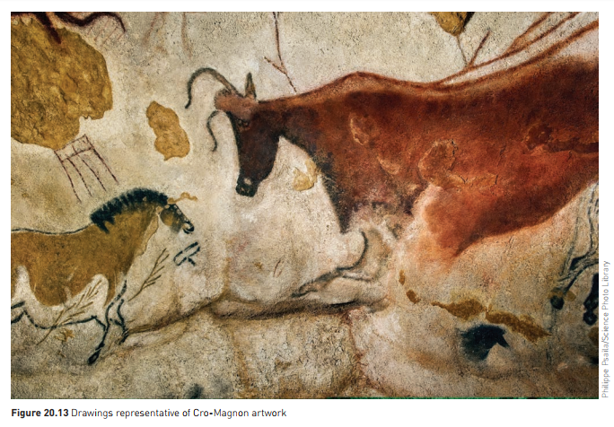

Slide 21
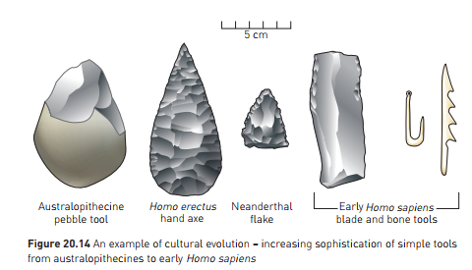

Slide 22
The beginning of agriculture
Big step in human history
Change from nomadic to village lifestyle
“Neolithic revolution”
Domestication of plant and animal species
Likely to have begun in South-West Asia, around Palestine
“Fertile Crescent”
12 500 years ago
Gathered wild grasses, which hybridised
Fertile hybrid: “Emmer”
Later hybrid; large grains, good for making flour, but could no longer by scattered by wind: had to be sown – agriculture!

Slide 23
The beginning of agriculture
Domestication of crops occurred independently at different sites around the world:
China – rice, millet, soybeans, yams
Central America – maize (corn), potato, sweet potato, bean, peanut, pumpkin, tomato
New World; more plants domesticated. Old World – more animals domesticated
11 000 years ago: animals domesticated
Sheep – south west asia
Pigs, cattle, goats, and other animals, over a longer period of time
Farming supplemented by fishing and hunting
Surplus grain could be stored
More people could be supported on less land
Settled life allowed development of new technologies

Slide 24
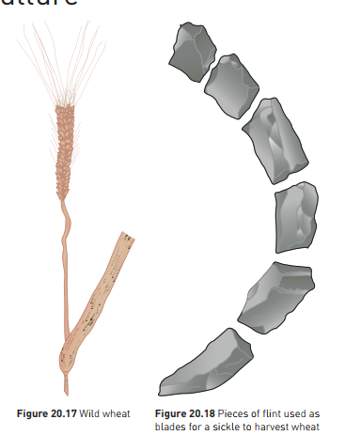

Slide 25
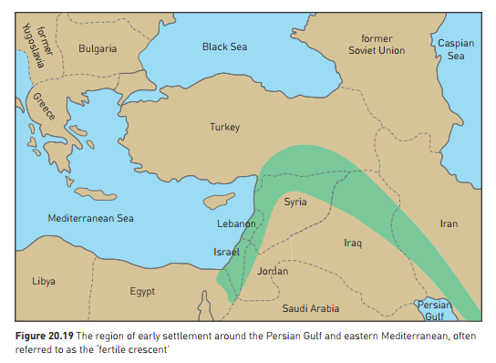

Slide 26
Modern Humans
We are able to manipulate our environment to a high level
Travel
Medical technology – life expectancy
Complex society
Important to understand human origins
Helps understand modern humans
Lifestyle diseases often because our cultural evolution has outstripped our biological evolution
Still challenges to survival, some of our own making
Climate change an immediately pressing issue
May be able to evolve culturally so we are able to slow down or reverse the change we are making.

